Slide 1
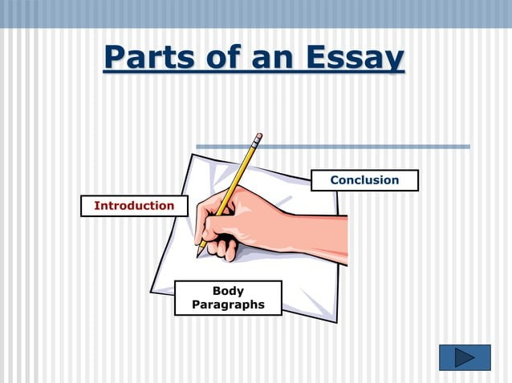
ESSAY WRITING

Slide 2
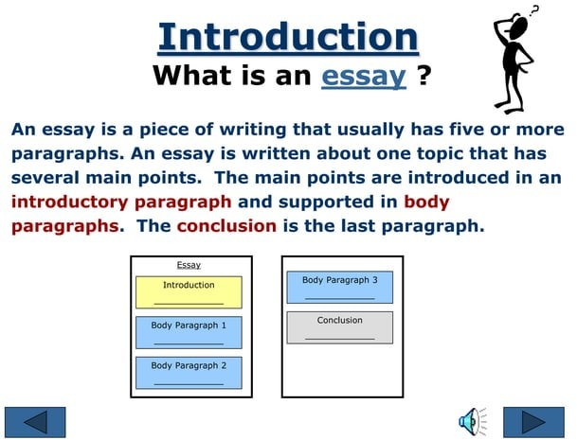

Slide 3
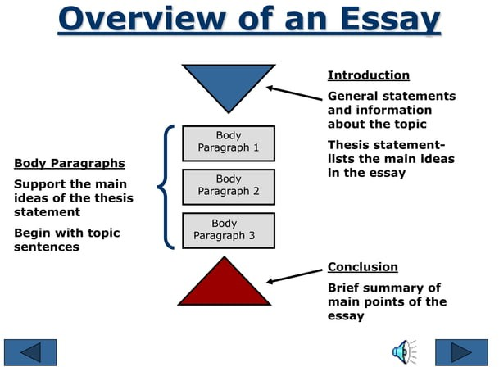

Slide 4
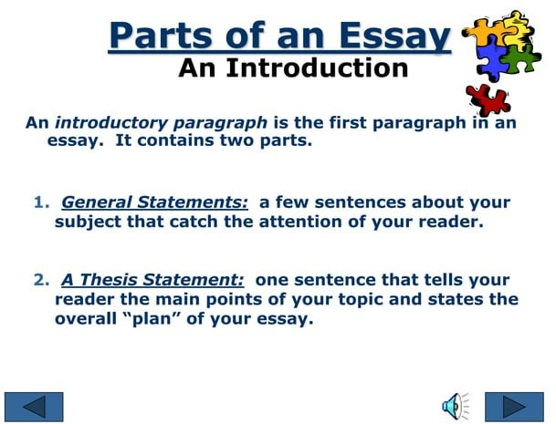

Slide 5
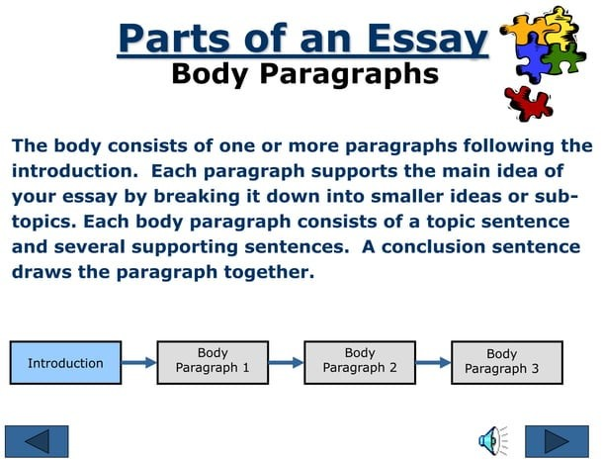

Slide 6
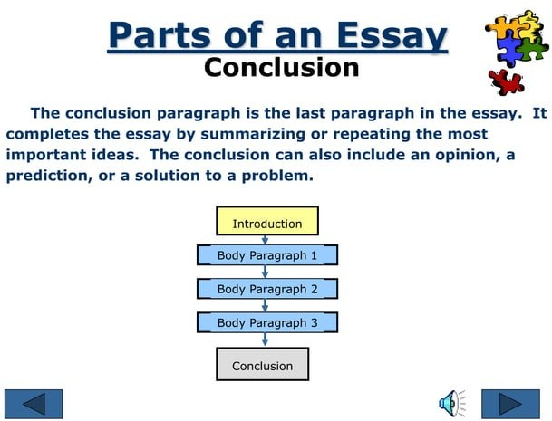

Slide 7
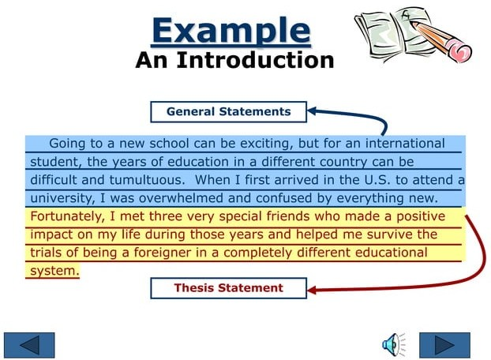

Slide 8
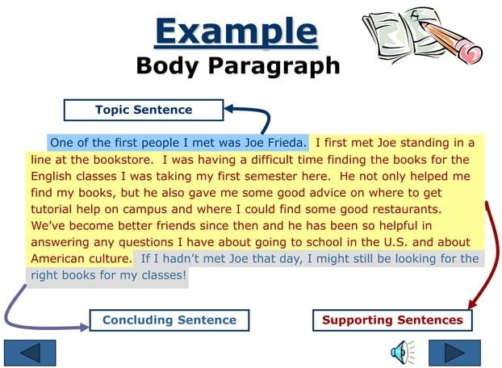

Slide 9
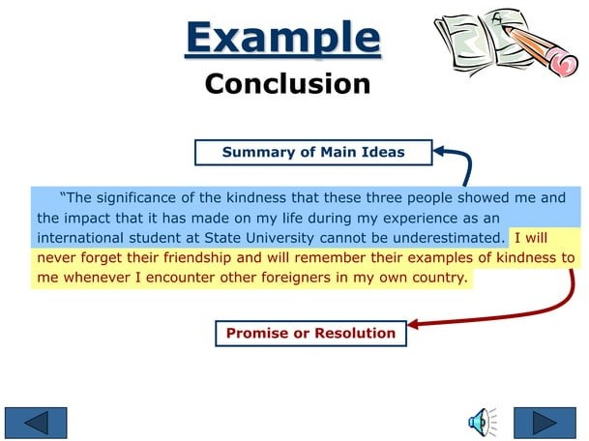

Slide 10
Example
An Introduction
Attention-Getter
“Metropolitan City is full of charm and scenic beauty, so visitors
from around the world come to enjoy its famous theaters,museums,
countless ethnic restaurants, and scenic wonders. Although
Metropolitan City seems like a paradise, it isn’t. The city has
several serious problems: poor public transportation, congested
streets, and expensive housing”
(Hogue, A. & Oshima, A., 1991, p. 92).
Thesis Statement

Slide 11
Example
Body Paragraph 1
Topic Sentence
“The first and most important problem is Metropolitan City’s inadequate
public transportation system. Thousands of residents rely on the city’s buses
and streetcars to travel throughout this large city, but Metro Transportation
System’s daily schedules are totally unreliable. A bus or streetcar that should
arrive at 7:45 may not arrive until 8:00 or later. Moreover, it is not unusual
for a bus driver to pass up groups of people waiting for the bus, because he
wants to make up for lost time. Unfortunately, people often end up going to
work late or missing important appointments. In order for people to get to
their destinations on time, people must allow for waiting time at the bus and
streetcar stops” (Hogue, A. & Oshima, A., 1991, p. 79).
Concluding Sentence
Supporting Sentences

Slide 12
Body Paragraph 2
The second major issue facing Metropolitan City is traffic congestion. With so many people trying to navigate through the city, the streets are constantly crowded, especially during peak hours. The downtown area, in particular, is plagued by frequent traffic jams that cause long delays. This congestion not only increases commute times but also leads to elevated levels of air pollution. Many residents find themselves spending hours stuck in traffic each day, which takes a toll on their productivity and quality of life. The current traffic situation also poses safety risks, as frustrated drivers may take risky actions to bypass the gridlock.

Slide 13
Body Paragraph 3
Another pressing problem is the high cost of housing in Metropolitan City. As the city grows in popularity, housing prices have soared, making it difficult for many residents to afford a decent place to live. Rents are especially high, with many families forced to live in cramped or substandard housing due to the expense. This shortage of affordable housing has led to an increased homeless population and has driven some residents to seek accommodations far from the city center, adding to the transportation and congestion issues. Without intervention, the cost of living will continue to push out lower-income residents and harm the city's diversity and vibrancy.

Slide 14
Example
Conclusion
Summary of Main Ideas
“In conclusion, Metropolitan City must improve its public transit system,
clear up the massive traffic jams caused by slow-moving traffic in the
downtown areas, and keep rentals down to affordable levels. In other words,
Metropolitan City must improve its image, or it will soon become just another
mediocre city due to the lack of administrative responsibility to solve these
unfortunate problems”
(Hogue, A. & Oshima, A., 1991, p. 79).
Prediction

Slide 15
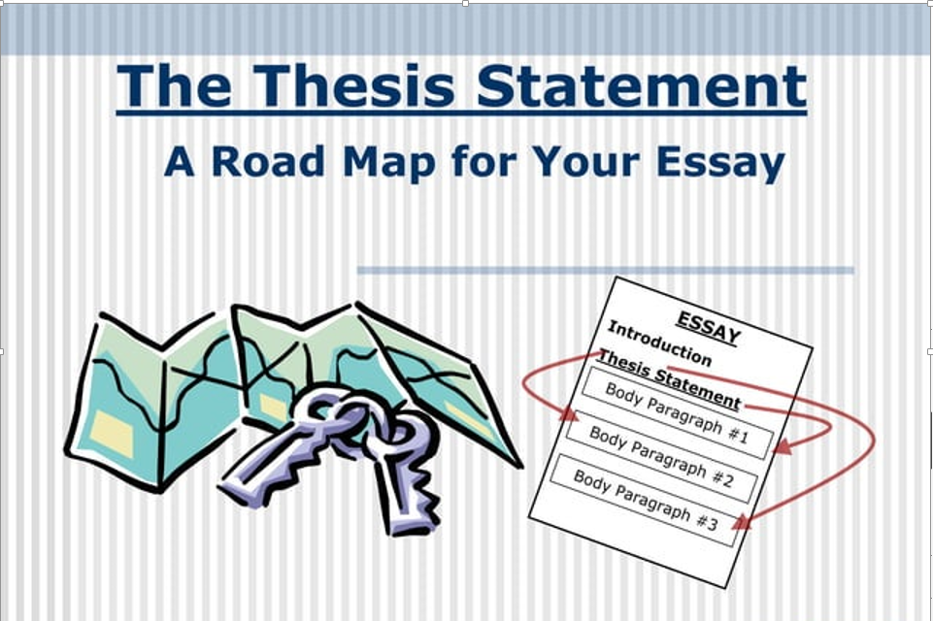

Slide 16
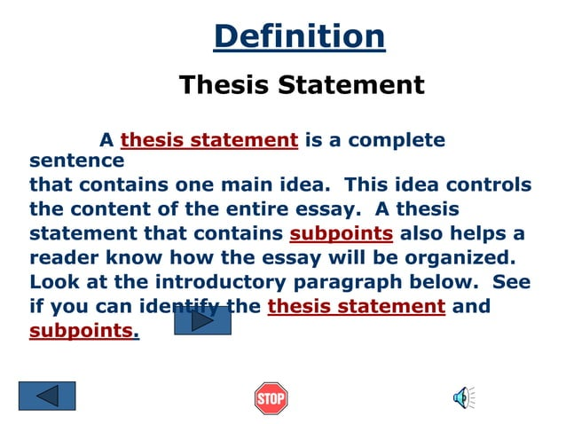

Slide 17
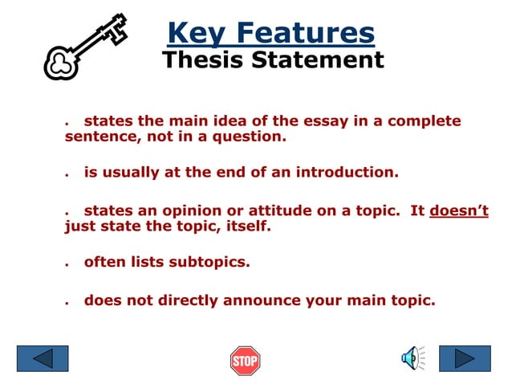

Slide 18
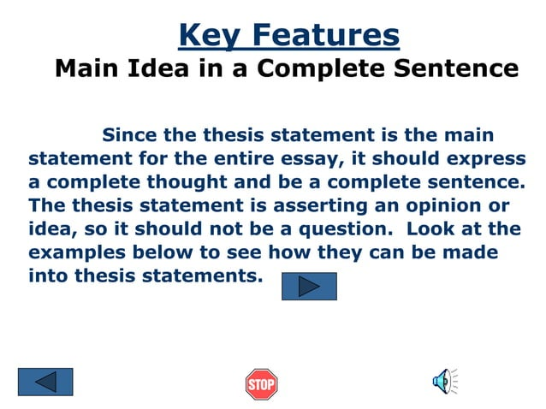

Slide 19
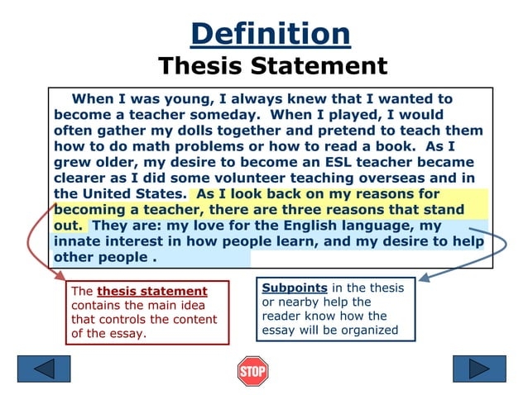

Slide 20
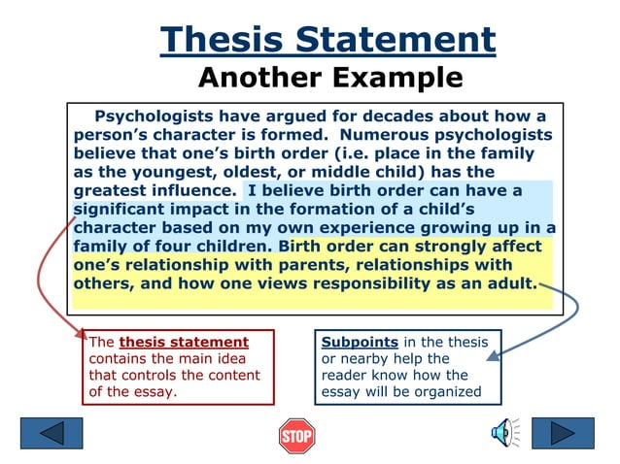

Slide 21
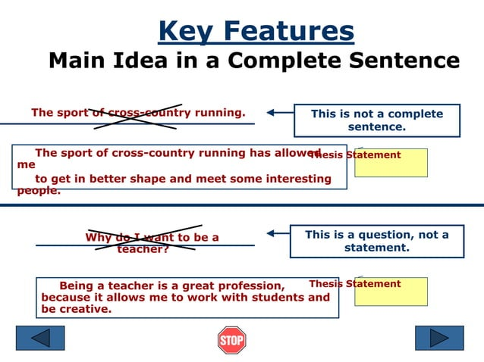

Slide 22
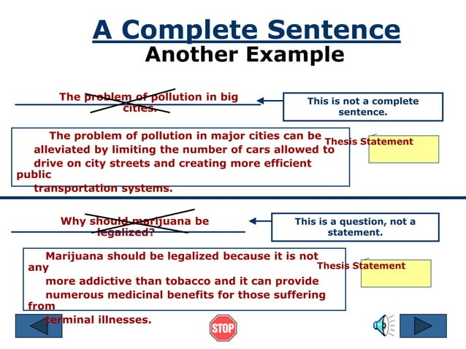

Slide 23
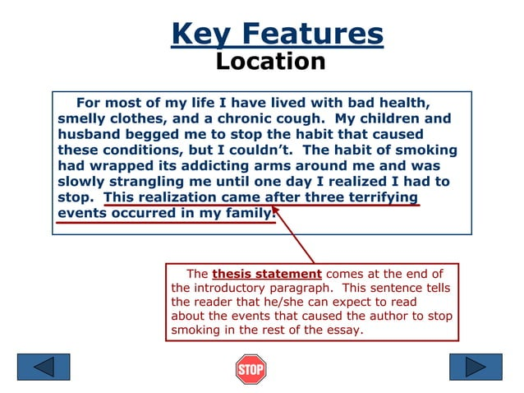

Slide 24
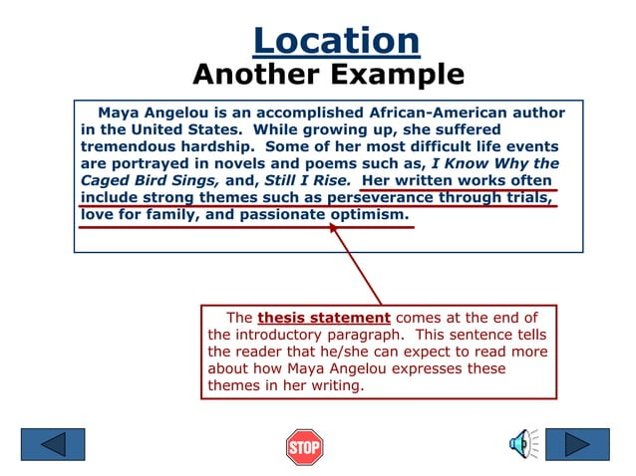

Slide 25
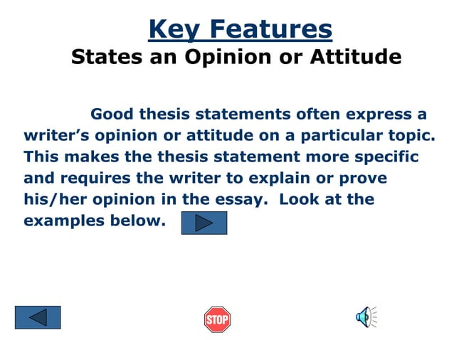

Slide 26
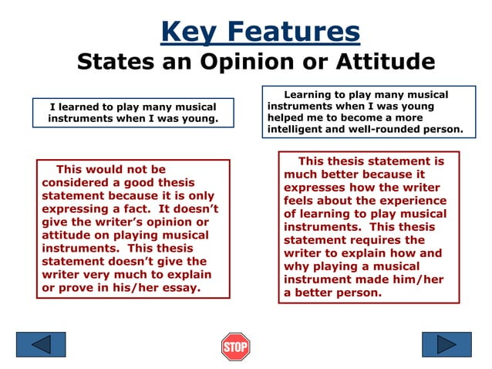

Slide 27
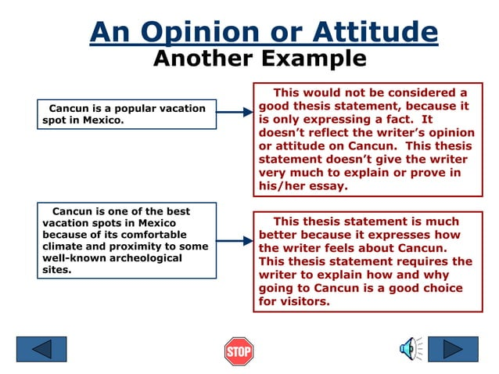

Slide 28
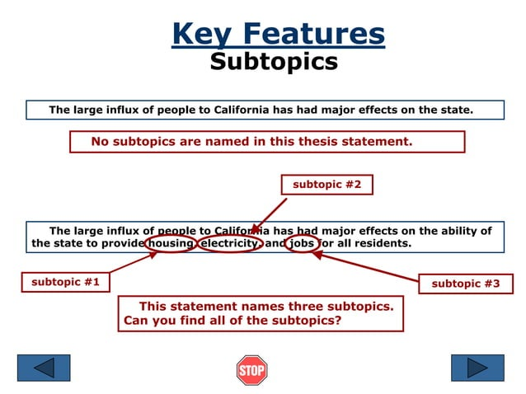
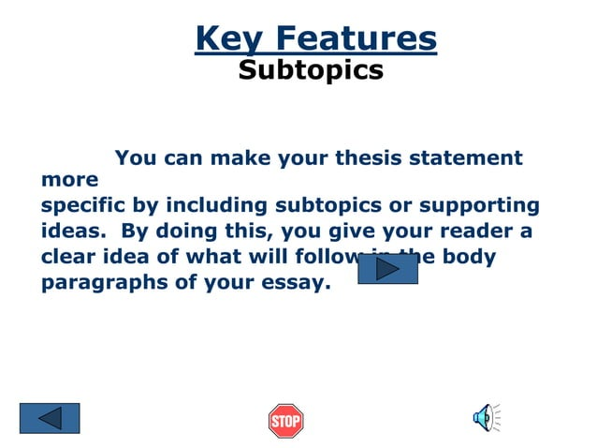

Slide 29
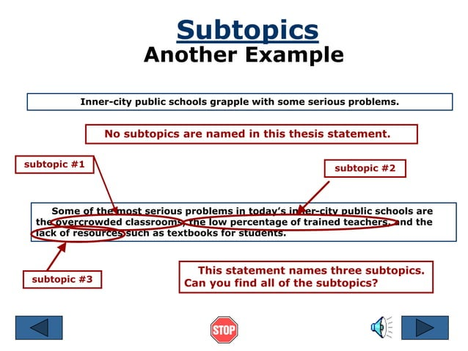

Slide 30
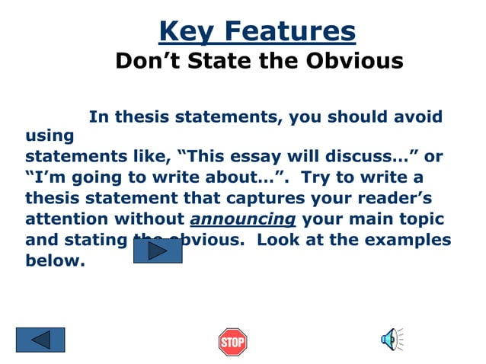

Slide 31
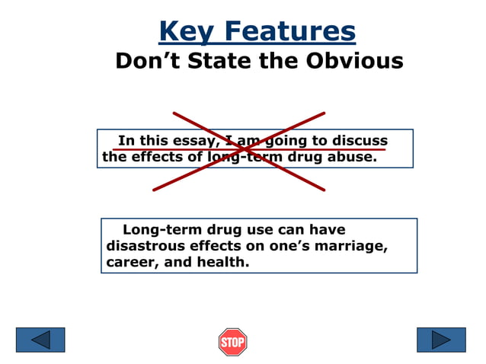

Slide 32
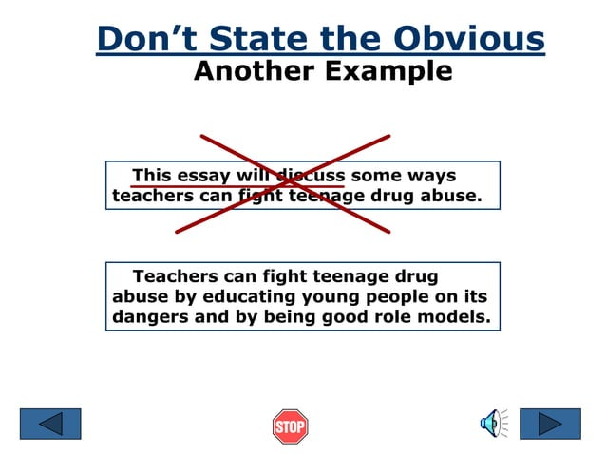

Slide 33
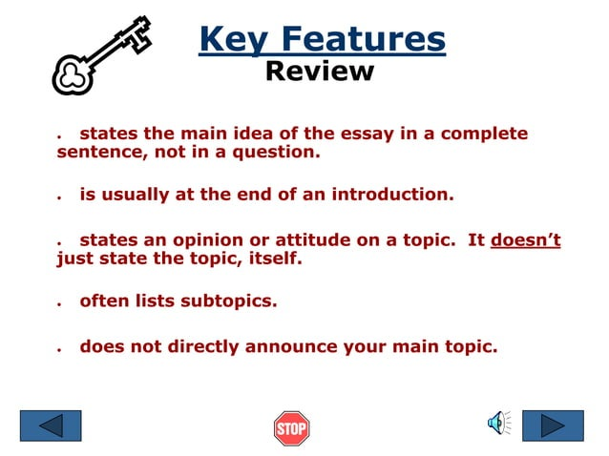

Slide 34
Use of transition words to link your ideas together
For exceptions: However, nevertheless, but, yet, still
For emphasis: Above all, finally, more importantly
For understanding: In other words, in essence, briefly
For summarizing: In conclusion, to sum up, for these reasons, in a nutshell
For exams: Remember this, this is important, this could be on the test
For examples: For example, for instance, to illustrate
For organization or chronological order: The six steps are…, next, finally first, secondly, third
For additional points: Furthermore, in addition, also, moreover
For opposing ideas: On the other hand, in contrast, although, however
For similar ideas: Likewise, similarly, in comparison

Slide 35
THANK YOU

